Slide 1


Impacts of Model Grid resolutions
UNCLASSIFIED
Lauren Melendez
U.S. Army Engineer Research and Development Center, Environmental Laboratory
CE-QUAL-W2 Workshop
July 08 - 09, 2024
Environmental Systems
Modeling Team
UNCLASSIFIED

Slide 2
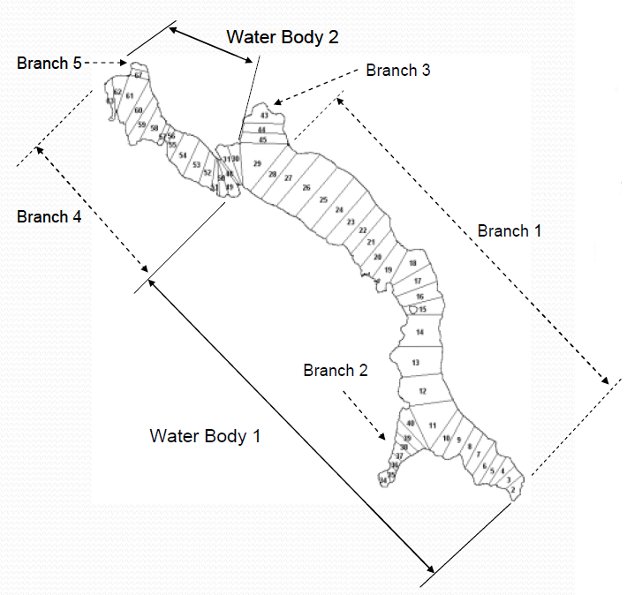
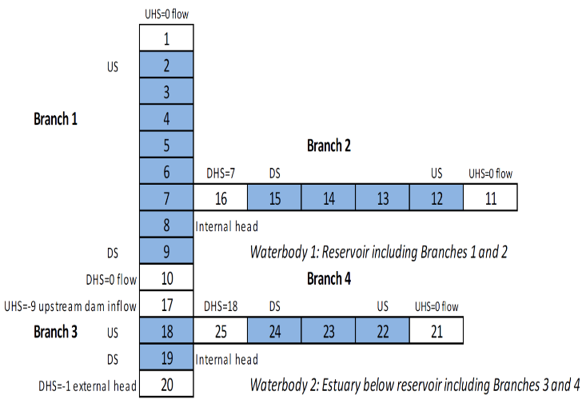
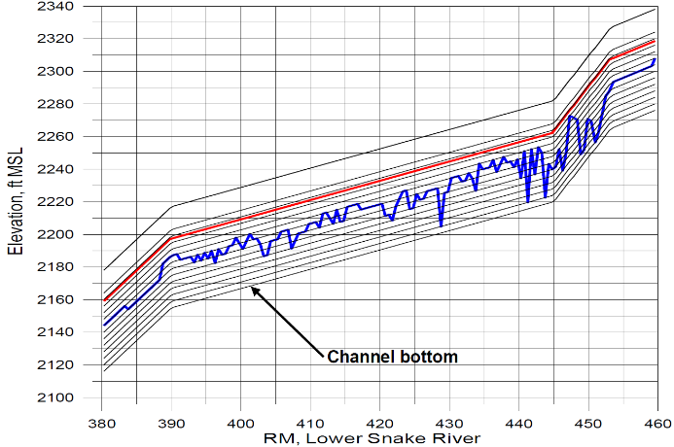
CE-QUAL-W2 Model Grids
Waterbodies/Branches/Segments/Layers
Segments (a longitudinal segment of length ∆x)
Layers (a vertical layer of height ∆z).

Slide 3
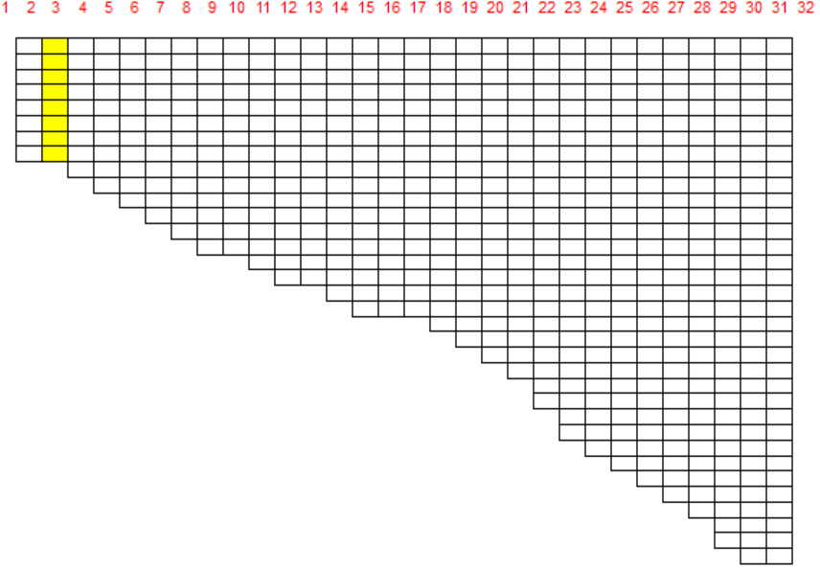
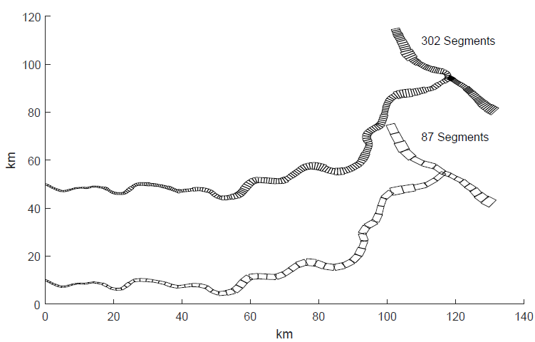
CE-QUAL-W2 Model Grids
Defining the spatial resolution (∆x and ∆z) for the model domain
∆x = 100 m to 1 km, ∆z = 0.5 – 1 m
Increasing spatial resolution can severe penalty in terms of turnaround time for running the model
Model results should not be a function of the grid resolution or the model timestep.
Model layer

Slide 4
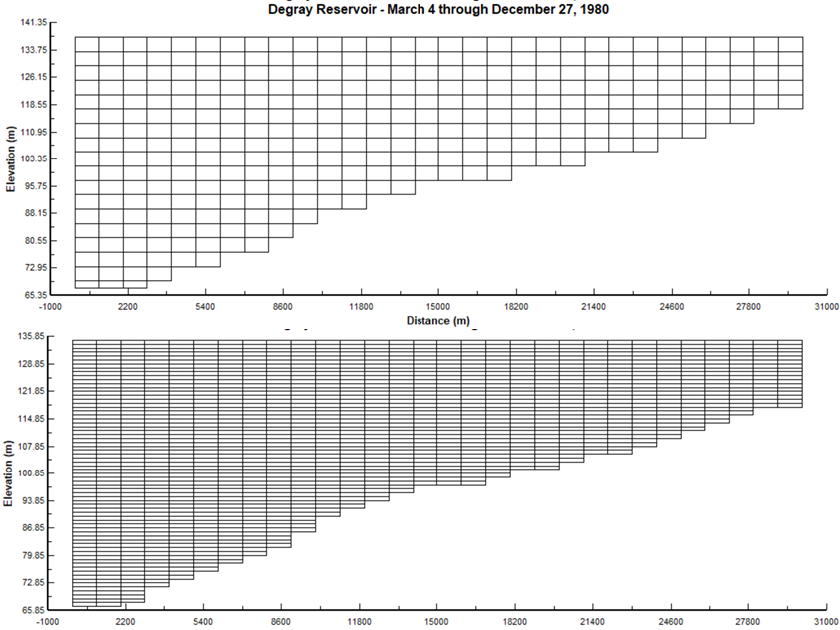
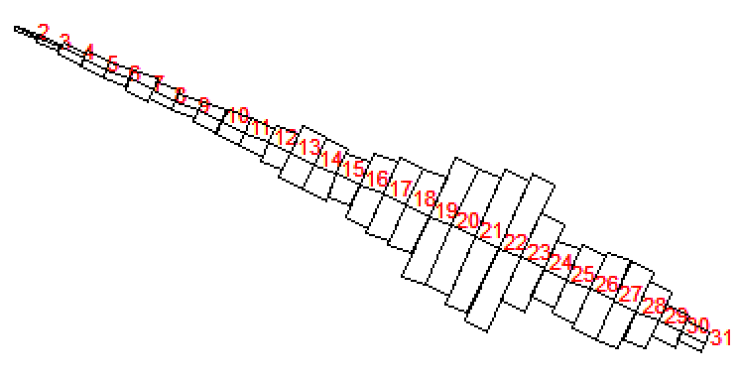
Model Grids - DeGray Reservoir
Branch length 30 km
Segment lengths 1000 m
Maximum width 5530 m
Layer height 2 m
Upstream segment 2
Downstream segment 31
∆z = 2m
∆z = 1m

Slide 5
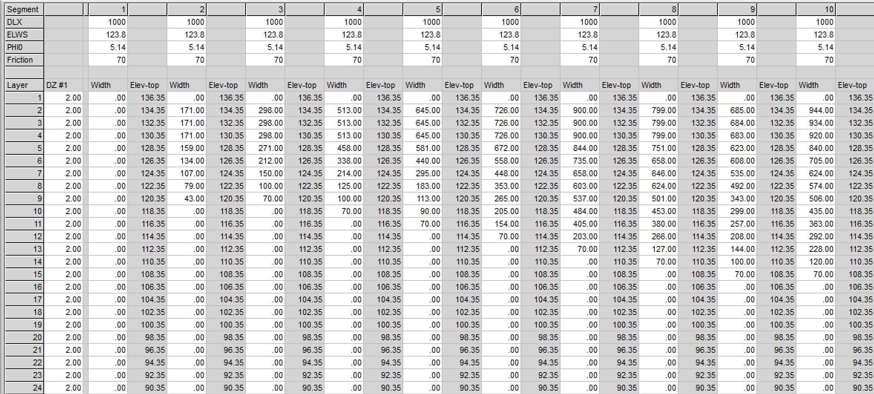
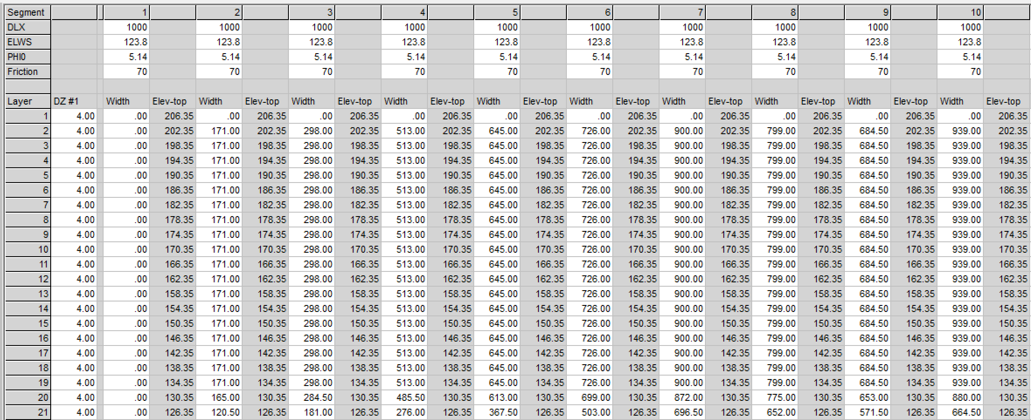
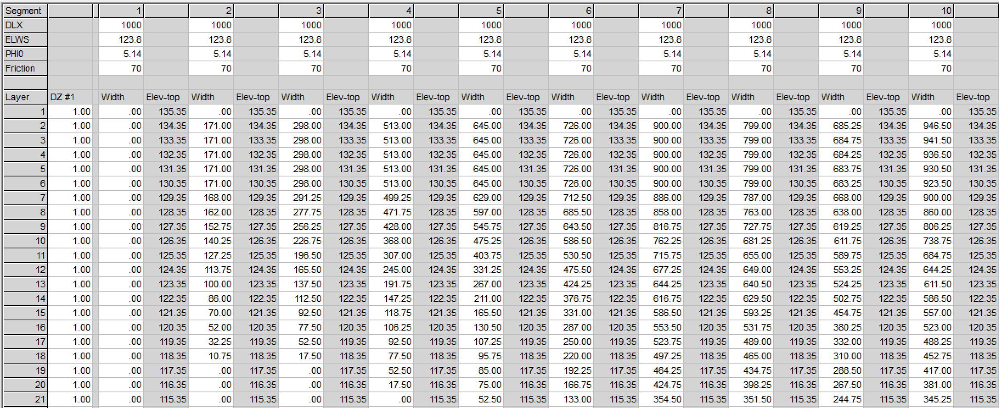
DeGray Bathymetry Files (2m, 1m, 4m)
∆z = 4m
∆z = 2m
segment lengths
water surface elevations
segment orientations
bottom friction
layer heights for each segment, and
average widths for each grid cell.
∆z = 1m

Slide 6
DeGray Reservoir Elevation vs Volume
pre.opt created from the W2 preprocessor contains the model area-volume vs. elevation data.
Comparison of reservoir stage-volume curves for three model grids.

Slide 7
DeGray Modeled Water Temperature Profiles

Slide 8
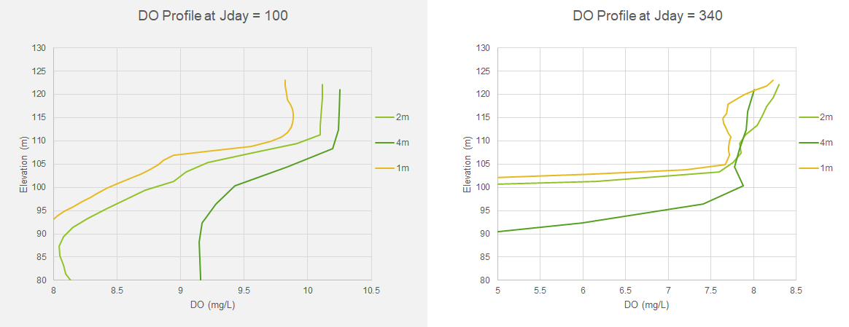
DeGray Modeled Dissolved Oxygen (DO) Profiles

Slide 9
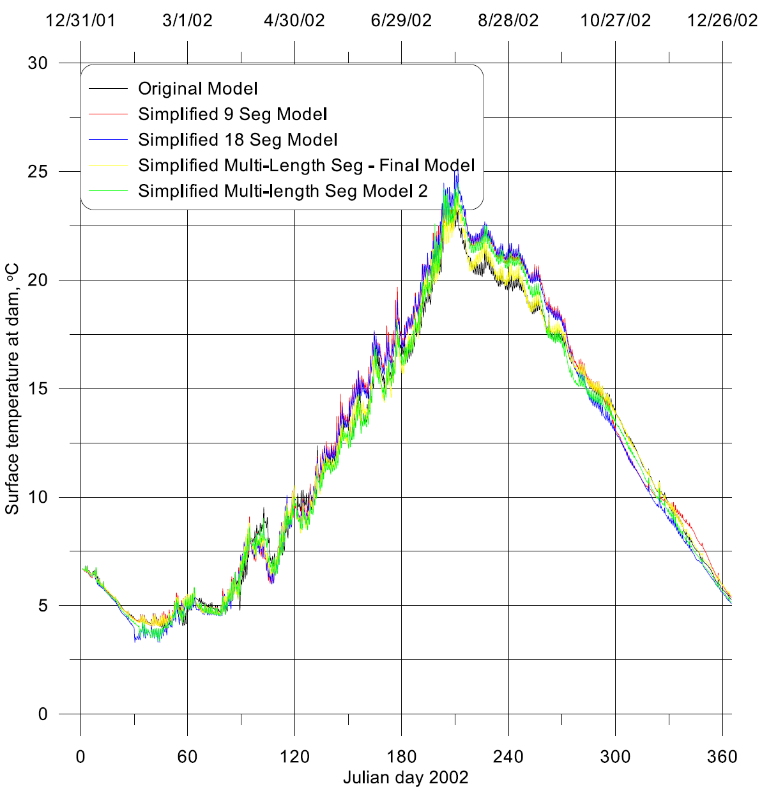
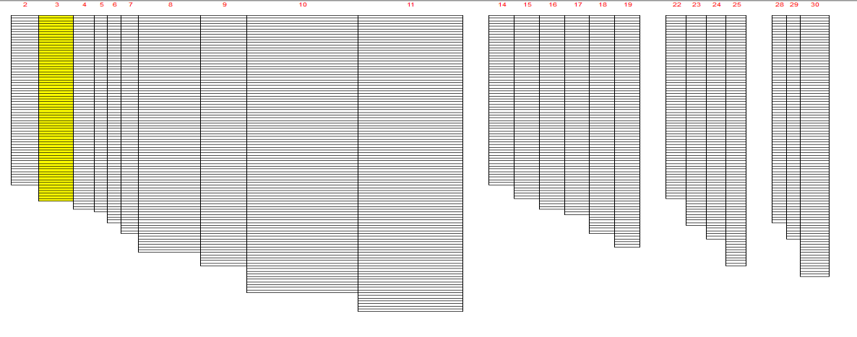
Detroit Lake W2 Model
The final model chosen (shown in yellow) tracked the original outlet temperatures (shown in black) very well.
The W2 model segments were modified to reduce the total number of segments (66 → 36).
When significantly coarsening a model grid, some of the finer details of the flow and temperature dynamics were lost.
Courtesy of Scott Wells

Slide 10
Hands-on Exercises
Review the differences of bathymetry files from “DeGray W2 Project”
Layer height = 2 m (bth1.csv)
Layer height = 1 m (bth1-1m.csv)
Layer height = 4 m (bth1-4m.csv)
Compare the differences of following predicted results for the 2 m, 1 m and 4 m layer heights
water temperature and dissolved oxygen profiles (spr.csv)
withdrawal output (two_31.csv)

Slide 11

Questions?

